Slide 1
DONOR CARE

Slide 2
Role of Motivators & Camp Organisers
A) RECEPTION OF DONORS
l Donors should feel they are WANTED
l Sincere Volunteers to be deployed
l Volunteers Must NOT leave their POST

Slide 3
Reception Table
Reception of Donor

Slide 4
B) ESCORTS
l Learned & JOVIAL Volunteers
l QUERIES of Donors to be satisfied
l Pre & Post donation ADVISE

Slide 5
C) BED SIDE VOLUNTEER
Bed side volunteers helps to eliminate fear complex
Company and Confidence
Interaction with donor
Satisfy donor’s curiosities

Slide 6
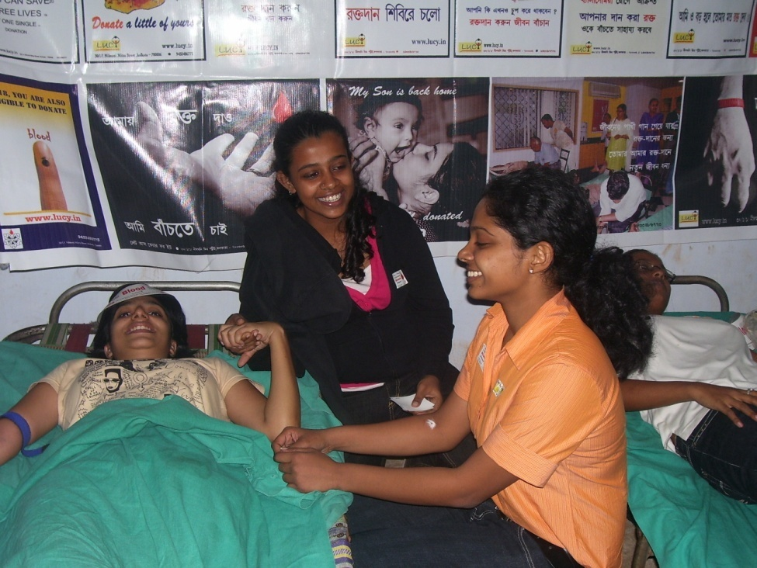
BED SIDE VOLUNTEERS

Slide 7
D) PUNCTUALITY
Unnecessary waiting will irritate the donor
Donors should be well informed about the start & end time
OBSERVE Doctors while screening
OBSERVE technicians involved
E) DONOR SCREENING

Slide 8
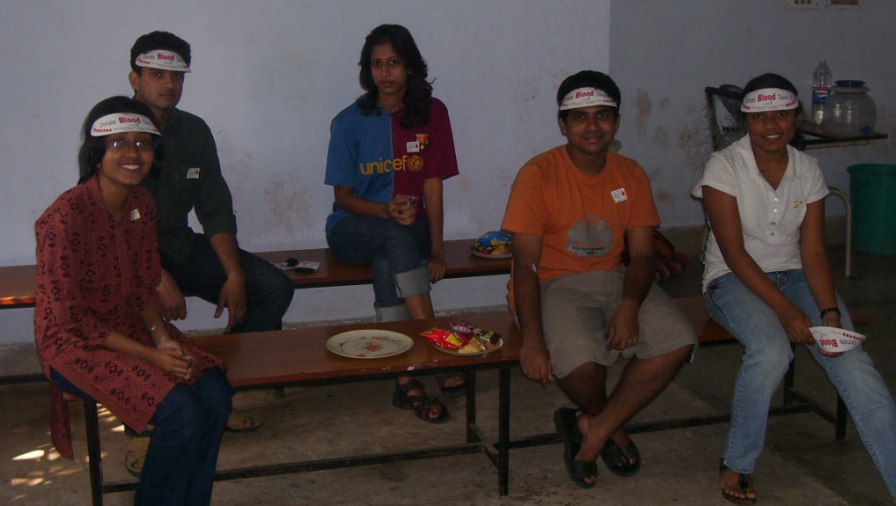
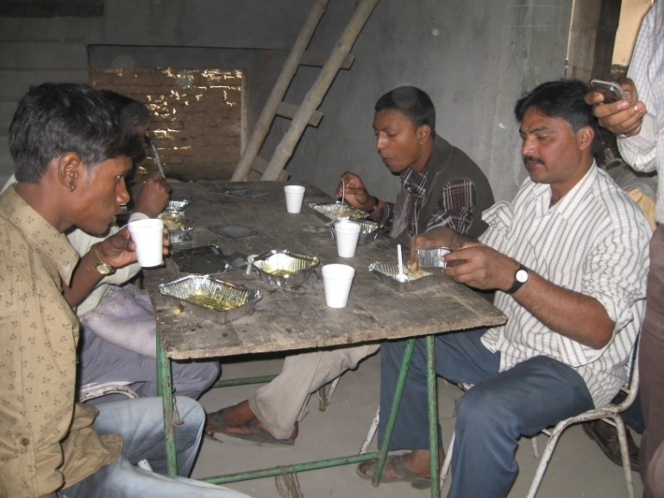
F) REFRESHMENT
Arrangement of Proper Refreshments
NO Carbonated drinks
Volunteers along with Donor
Untidy refreshment area

Slide 9
G) AMBIENCE OF CAMP
Properly ventilated donation site
Proper sanitation facilities
Privacy of Donor in screening area
AVOID Overcrowding
Decoration of the camp with IEC materials

Slide 10
Decorated Camps create a good Ambience

Slide 11
Cultural Program in Camps to motivate Donors

Slide 12
Over Crowding

Slide 13
H) BEHAVIOUR
Appearance of the organisers
Team members must show respect to themselves and the donors
Cheerful and energetic body language of the organisers & Medical team
Genuine ready SMILE

Slide 14
Cheerful Volunteers with genuine ready SMILE

Slide 15
I)HANDLING COMPLAINTS
Complaints handled with equanimity
Keep aside the emotions
Donor’s version listened with compassion
Information provided is to be clarified
Take necessary actions

Slide 16
Donor care
RECOGNITION

Slide 17
J) WAVING GOOD BYE
A THANK YOU with a hearty smile
SPECIAL CARE for Donor undergone vasovagal reactions
Donor recognition
A phone call in the evening

Slide 18
Role of Blood Collection Team in Donor Care:
A) DONOR SCREENING
Proper Weight measurement of Donors
Measurement of Haemoglobin level is a must
Questionnaires shall be properly asked and filled
Sensitive approach for donor reactions

Slide 19
Closed Door Screening
Open House Screening

Slide 20
B) TRAINED TECHNICIANS
Complications like...
HAEMATOMA, Multiple Pricking, Nerve Damage at venepuncture site, Puncture of ARTERY instead of VEIN, INFECTION at Venepuncture can be avoided to a large extent with properly trained phlebotomist.

Slide 21
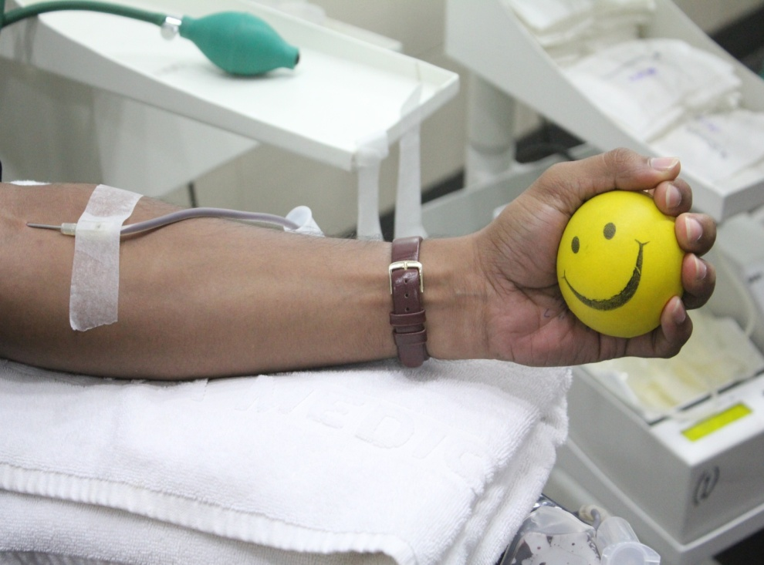
Proper Venepuncture
Improper Venepuncture

Slide 22
AT LAST…
It’s the duty of the whole team comprising volunteers, motivators, organisers, doctors and phlebotomists to keep in mind about the CARE of the donor while carrying out the donation procedure.

Slide 23
Thank You

